Slide 1

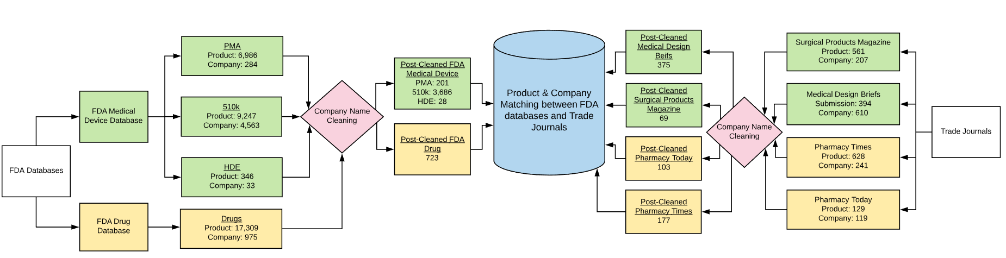
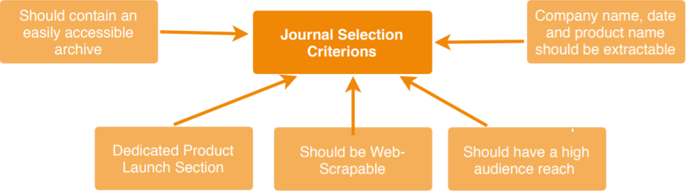
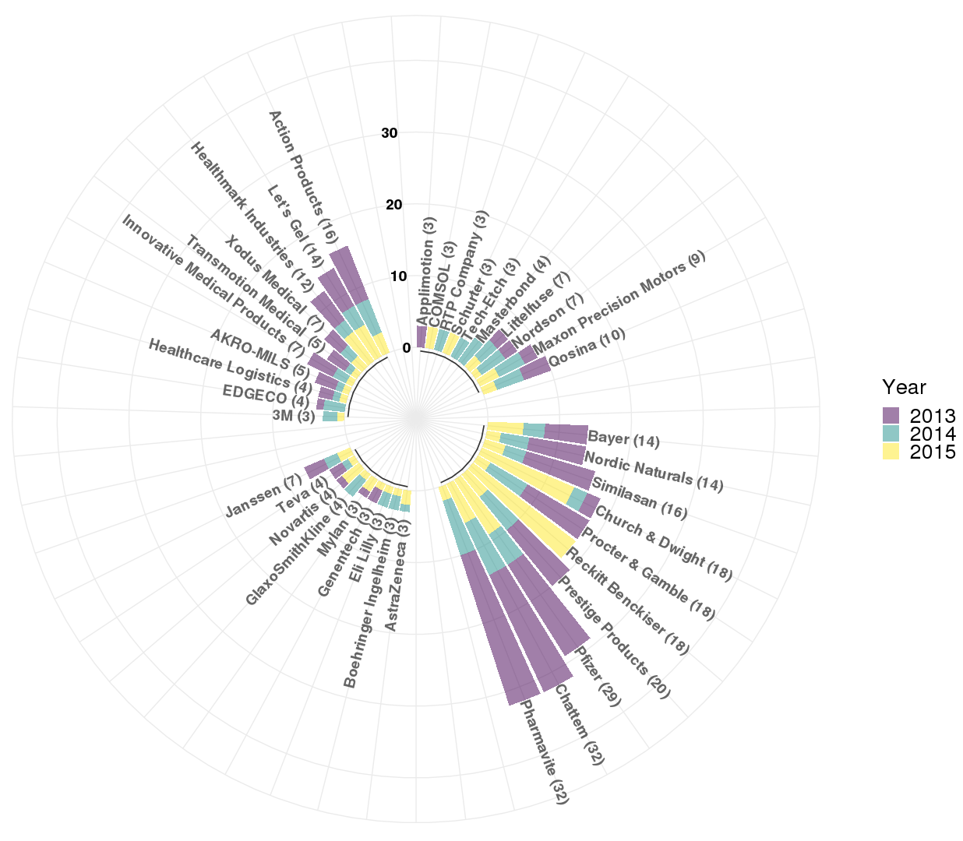
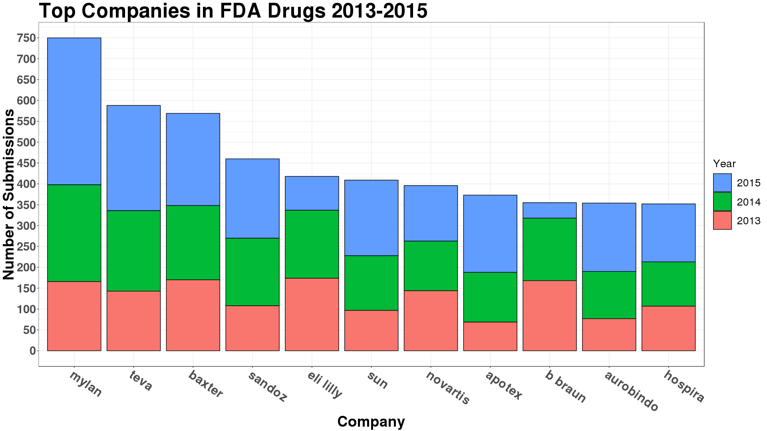
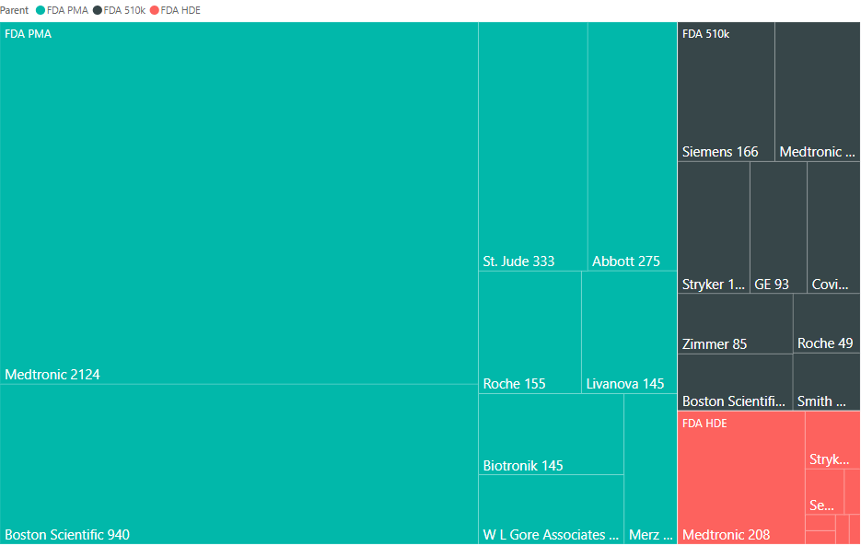
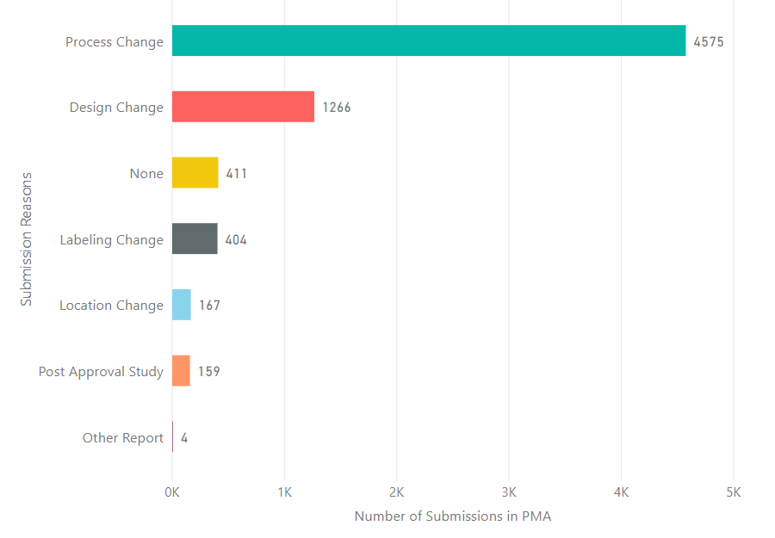

Measuring Product Innovation in the Pharma Industry
Using Nontraditional Data Sources
Eirik Iversen (VT), Luke Kim (VT), Raghav Sawhney (VT), Fangfang Lee (NYU) and Bayoán Santiago Calderón (CGU)
SDAL: Gizem Korkmaz, Ian Crandell, and Stephanie Shipp
Sponsor: Gary Anderson, The National Center for Science & Engineering Statistics (NCSES) at the National Science Foundation (NSF)
Introduction
• Innovation is traditionally measured through surveys of selected companies (e.g., Business R&D and Innovation Survey (BRDIS)). While BRDIS measures innovation incidence, i.e., the number of innovating firms, NCSES is interested in exploring the possibility of using non-traditional data to enrich and complement innovation measures. This project aims to test the feasibility of developing methods to measure business innovation using non-traditional data sources focusing on opportunity and administrative data (e.g., product announcements, press releases, websites and other information obtained through web scraping or queries of selected companies).
• Our current focus is on Pharmaceutical Drugs and Medical Devices that are heavily regulated by the Food and Drug Administration (FDA). This is appealing because there is a lot of public information about these products on FDA sources. We identify the industries by
their 4-digit NAICS (North American Industry Classification System) codes:
3254-Pharmaceutical and Medicine Manufacturing & 3391-Medical Equipment and Supplies Manufacturing
• The goal is to match the product approvals documented in FDA databases to new product announcements in all data sources to compare to the new products covered in trade journals.
Data and Methods
FDA Databases
Drugs @ FDA website provides a comprehensive list of all drug approvals up-to-date.
Medical Devices are classified by the level of risk on the user/patient by the FDA:
PMA (Pre-Market Approval): Includes Class III devices which have the highest risks and need the most examination. It takes a long time to process a PMA and is usually the most expensive approval process.
510k (Pre-Market Approvals): Includes Class II devices that have moderate risk and are approved by being “Substantially Equivalent” to devices that have previously been approved.
HDE (Humanitarian Device Exemption): This is the process where medical devices are allowed to be marketed without requiring evidence of effectiveness.
*Note: Class 1 devices do not need FDA approval in most cases.
Trade Journals
As a part of our trade journal discovery, we studied similar research, e.g., [1] and [2], to obtain a list of trade journals, to understand their methods and criteria for selecting the relevant journals.
We selected 4 trade journals from a larger compiled list to be web-scraped for product innovations based on the criterions given on the right.
  Drugs: Pharmacy Times and Pharmacy Today
  Medical Devices: Medical Design Briefs and Surgical Products Magazine
We used the Levenshtein Distance method [3] to identify name standardization issues and created a set of rules and applied them to all data sources.
Challenges
  Company names can vary across data source
Further complicated by parent-subsidiary relationships, mergers, company divisions and cooperative projects.
Findings
FDA Drug Database (2013 - 2015)
17,309 drug approvals (1,820 original submissions) and 723 companies.
Top 10 companies with the highest number of approvals are given below.
Trade Journals
Top published companies by trade journal
Matching Companies in Data Sources
Number of unique companies in each data source (2013-2015)
Data Source | Number of companies (after cleaning) | Number of companies matching FDA | Total number of FDA approvals for these companies | Total number of new products in trade journal for these companies (% FDA approval)
FDA Medical Device Database | 3,915
Medical Design Briefs | 375 | 13 | 384 | 17 (4.43%)
Surgical Products | 69 | 17 | 344 | 29 (8.43%)
FDA drugs | 723
Pharmacy Times | 177 | 68 | 4,950 | 249 (5.03%)
Pharmacy Today | 103 | 57 | 6,328 | 91 (1.44%)
Surgical
Products
Medical
Designs
Pharmacy
Times
Pharmacy
Today
We have identified the above company matches across these data sources. The goal is to identify new product announcements that are covered in trade journals in the FDA drug and medical device approval databases.
FDA Medical Device Databases
Top companies for each submission type (indicated by different colors). The approval counts are given next to the company names.
Next Steps
Obtain product approval counts by submission and supplement types as some of these types (e.g., location change) will not count as innovation, hence may not be announced in the trade journals.
Match at the product level and and aggregate by company and industry
Develop more advanced methods for company name standardization and acquire new data sources for more specific information on industry and companies (e.g., subsidiaries, revenue, size)
Identify additional trade journals from the literature and based on the industry experts’ uses
Introduce additional data sources: SEC filings, press releases from company websites
Extend the methods to other industries (e.g., automotive, technology)
FDA pre-market approval (PMA) by submission type
References
[1] Edwards, K. L., & Gordon, T. J. (1984). Characterization of innovations introduced on the US market in 1982. Futures Group; Reproduced by NTIS.
[2] Acs, Z. J., & Audretsch, D. B. (1988). Innovation in large and small firms: An empirical analysis. The American Economic Review, 678-690.
[3] Levenshtein, Vladimir I. (1966). Binary codes capable of correcting deletions, insertions, and reversals. Soviet Physics Doklady. 10 (8): 707–710.
facebook.com/biocomplexity
twitter.com/biocomplexityvt
youtube.com/c/biocomplexity
google.com/+biocomplexity
DELETE THIS BLUE BOX
{PLACEHOLDER ONLY}
This is an allowable area for your
sponsor logos or school affiliation logos
DO NOT PLACE LOGOS IN TITLE AREA
Stay Connected:
Notes:
GENERAL RULES TO FOLLOW:
Stay in Google Slides to work on your poster because it:
provides a template with all the approved branding including colors, fonts, and logo placement/usage;
allows you to collaborate with others;
helps you to communicate with your fellow researchers, lab./dept., and creative services;
Editing this file:

